Slide 1
Control Flow Deobfuscation via Abstract Interpretation
© Rolf Rolles, 2010

Slide 2
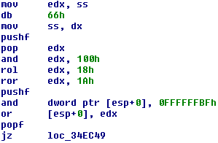
Obfuscated Target Example
1-3: Manipulations to ss are anti-debugging
4-5: edx = flags
6: Mask off everything but TF
7-8: Shift TF into ZF position
9: Push flags again
10: Mask off ZF from #9
11: OR flags with the TF in the ZF position
12: Restore flags
13: JZ false_branch (if TF was set)
Jump is taken if the code is being traced, not taken if the code is not being traced.

Slide 3
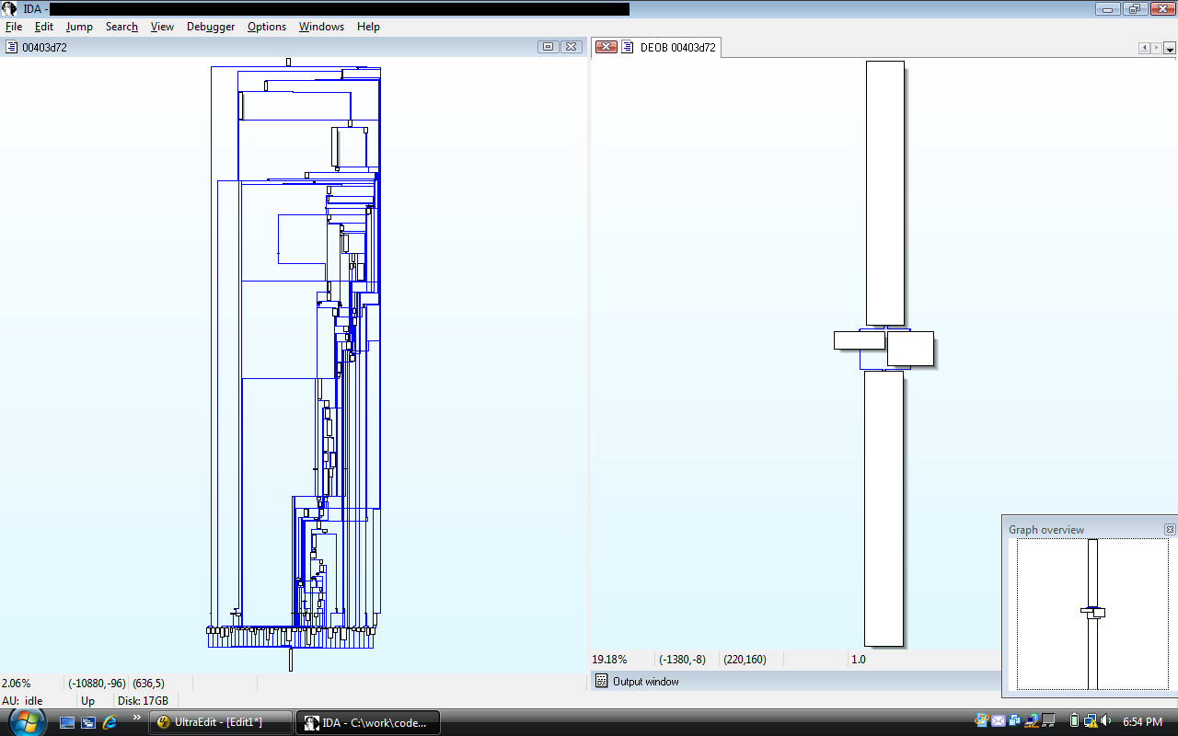
Obfuscated Control Flow Graph
Left-hand side: a control flow graph with obfuscation
Right-hand side: deobfuscated control flow graph

Slide 4
What does “breaking” this construct mean?
Determining in which direction each TF-based jump goes.
Feeding that information into a higher-level analysis, e.g. a disassembler with a graphing component, to automatically prune the half-dead branches and the relevant dead code.
We focus on #1.

Slide 5
A Syntactic Pattern for this Construct
1) Through observation of the binary, the construct always begins with manipulations to ss
2) This is immediately followed by a pushf
3) There are various manipulations to the flags register (bitwise and linear arithmetic), perhaps across multiple registers
4) A conditional jump

Slide 6
Syntactic Patterns in General
They suck: in AV, in IDS, and in anything you could think of calling principled computer security
I don’t care what it looks like, I care what it does: how can we describe anti-tracing checks at their most base level, with no reference to how it is actually accomplished?

Slide 7
A Very Generic Semantic Pattern
A bit in a quantity (e.g., the TF bit resulting from a pushf) is declared to be a constant (e.g., zero), and then this bit is used in further manipulations of that quantity.
  Reminiscent of the constant propagation problem, except on the bit-level

Slide 8
Problem: Unknown Bits
Supposing that only certain bits are known to be constant, how do we handle the non-constant ones?
What happens when we and, or, xor, inc, dec, neg, not, shl, shr, sar, ror, rol, rcr, rcl, mul, imul, div, and/or idiv quantities that contain non-constant bits?

Slide 9
Solution: Fantasyland
Let’s pretend that bits have three values instead of two:
  Zero
  One
  Maybe/Half
Model registers (and memory) as (arrays of) three-valued bitvectors.
How does this affect the bitwise/integer operations available within the language?

Slide 10
Bitwise Operations: XOR, AND, OR, NOT
XOR | 0 | ½ | 1
0 | 0 | ½ | 1
½ | ½ | ½ | ½
1 | 1 | ½ | 0
AND | 0 | ½ | 1
0 | 0 | 0 | 0
½ | 0 | ½ | ½
1 | 0 | ½ | 1
OR | 0 | ½ | 1
0 | 0 | ½ | 1
½ | ½ | ½ | 1
1 | 1 | 1 | 1
NOT | 0 | ½ | 1
 | 1 | ½ | 0
These operators work exactly like you would expect.

Slide 11
Bitwise Operations: Shifts, Rotates
½ | 0 | 1 | ½ | 0 | 1 | ½ | 0
A BOOL3-bitvector
0 | 1 | ½ | 0 | 1 | ½ | 0 | 0
Bitvector << 1
0 | ½ | 0 | 1 | ½ | 0 | 1 | ½
Bitvector >> 1
½ | ½ | 0 | 1 | ½ | 0 | 1 | ½
Bitvector SAR 1
Rotate operations are decomposed into combinations of shifts and ORs, so they are covered as well.

Slide 12
Integer Operations: Addition
How concrete addition works:
At each bit position, there are 2³ possibilities for A[i], B[i], and the carry-in bit. The result is C[i] and the carry-out bit.
Carry-Out | 0 | 1 | 1 | 1 | 1 | 0 | 0 | 0
A[i] | 0 | 1 | 0 | 1 | 1 | 0 | 1 | 0
B[i] | 0 | 1 | 1 | 0 | 1 | 1 | 0 | 0
Carry-In | 1 | 1 | 1 | 1 | 0 | 0 | 0 | 0
Result | 1 | 1 | 0 | 0 | 0 | 1 | 1 | 0

Slide 13
Integer Operations: Addition
In abstract addition, A[i], B[i], and carry-in are BOOL3 terms, so we have 3³ possibilities at each bit position.
The derivation of the rules for bitwise abstract addition is straightforward.
Notice that the system is smart enough to determine that the addition of two N-bit integers is at most N+1 bits.
Carry-Out | 0 | 0 | 0 | ½ | ½ | ½
A[i] | 0 | 0 | 0 | ½ | ½ | ½
B[i] | 0 | 0 | 0 | ½ | ½ | ½
Carry-In | 0 | 0 | ½ | ½ | ½ | 0
Result | 0 | 0 | ½ | ½ | ½ | ½

Slide 14
Integer Operations: Negation
Neg(x) is equivalent to Not(x)+1.
We have previously given the rules for NOT and addition, therefore we have a rule for NEG as well.

Slide 15
Integer Operations: Subtraction
Subtraction is the same thing as addition, where the minuend is NOT-ed and the initial carry-in is set to one instead of zero.
Therefore, subtraction is trivially implemented based on the algorithms we have already discussed.

Slide 16
Integer Operations: Unsigned Multiplication
Consider B = A * 0x1230
0x1230 = 0001 0010 0011 0000
= 2¹² + 2⁹ + 2⁵ + 2⁴
=> B = A * (2¹² + 2⁹ + 2⁵ + 2⁴)
=> B = A * 2¹² + A * 2⁹ + A * 2⁵ + A * 2⁴
=> B = (A << 12) + (A << 9) + (A << 5) + (A << 4)
Addition and shifts by constants have previously been covered

Slide 17
Integer Operations: Unsigned Multiplication
In the abstract world, when the corresponding RHS bit is ½, we are either multiplying by 0 or 1, so we replace all 1 bits in the LHS with ½.
*
=
+
=
0 | 0 | 0 | 0 | 0 | 1 | ½ | ½
0 | 0 | 0 | 0 | 0 | 0 | ½ | 1
0 | 0 | 0 | 0 | 0 | 1 | ½ | ½
0 | 0 | 0 | 0 | ½ | ½ | ½ | 0
0 | 0 | 0 | ½ | ½ | ½ | ½ | ½

Slide 18
Integer Operations: Signed Multiplication
Similar to unsigned multiplication, with one-bit sign extensions at each intermediary step, and negation of the last partial product.
Read any book on digital logic for a more thorough explanation.

Slide 19
Relational Operations: Equals / Not Equals
Given two BOOL3 bitvectors A and B:
  If both are entirely constant, perform the comparison directly.
  If there exists j such that A[j] ≠ ½, B[j] ≠ ½, and A[j] ≠ B[j], then the quantities cannot be equal, so A = B is false, and A ≠ B is true.
  If there are no mismatches, and there are ½ bits, then we cannot make the determination, so we return ½.

Slide 20
That’s It
We described an abstract domain, the “bitvectors over BOOL3” domain, for quantities referenced within the language
We described abstract semantics for operators defined over the abstract quantities

Slide 21
Deobfuscation Of This Construct
Tell your program analysis framework to assume that the TF is not set during the pushf instruction
Analyze the code under the assumption of the partial constantness of the EFLAGS register with respect to the TF bit
Rewrite all conditional jumps that result from the value of the TF bit as unconditional jumps

Slide 22
Limitations
Bring-your-own memory model
  Current memory model is unsound but effective
Transfer functions in their current formulation are not monotonic
  Can only be applied locally to each basic block, instead of globally across the entire flow graph

